Slide 1

Heart Disease Diagnostic Analysis By Subhamoy Panja

Slide 2
Project Details
Project Title | Heart Disease Diagnostic Analysis
Technology | Data Science
Domain | Healthcare
Programming Language and Library Used | Python and Pandas, Matplotlib, Seaborn
Tools Used | Jupyter Notebook(Google Colab), MS-Excel, Tableau Public

Slide 3




Tools And Library Used

Slide 4
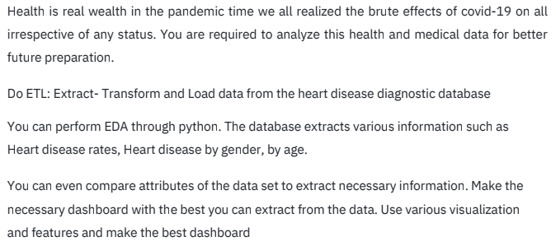
Problem Statement

Slide 5
Objective
The goal of this project is to analyze the heart disease occurrence, based on a combination of features that describes the heart disease. And also analyze this health and medical data for better future preparation.

Slide 6
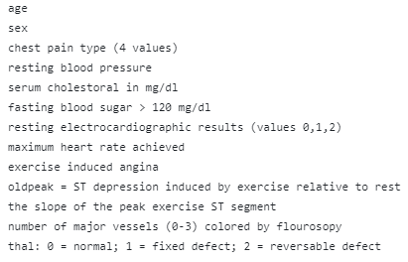
Attribute Details

Slide 7
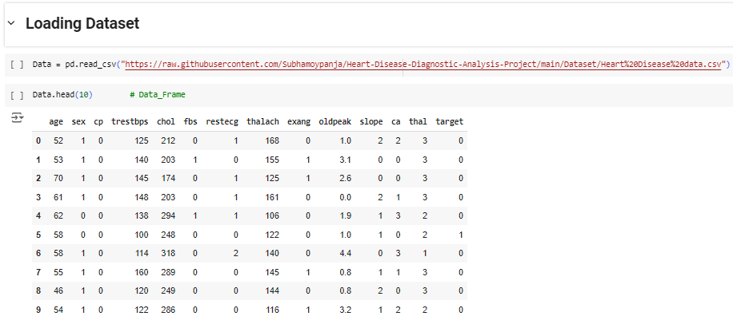
Dataset

Slide 8
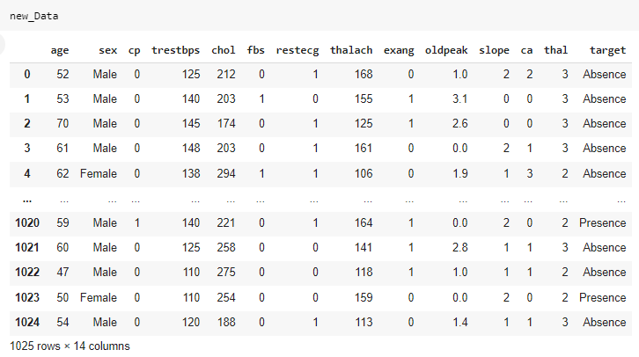
Modified Dataset
We have used 'Male' and 'Female' instead of 1 and 0 for "sex" column, 'Absence' and 'Presence' instead of 0 and 1 for "target" column.

Slide 9
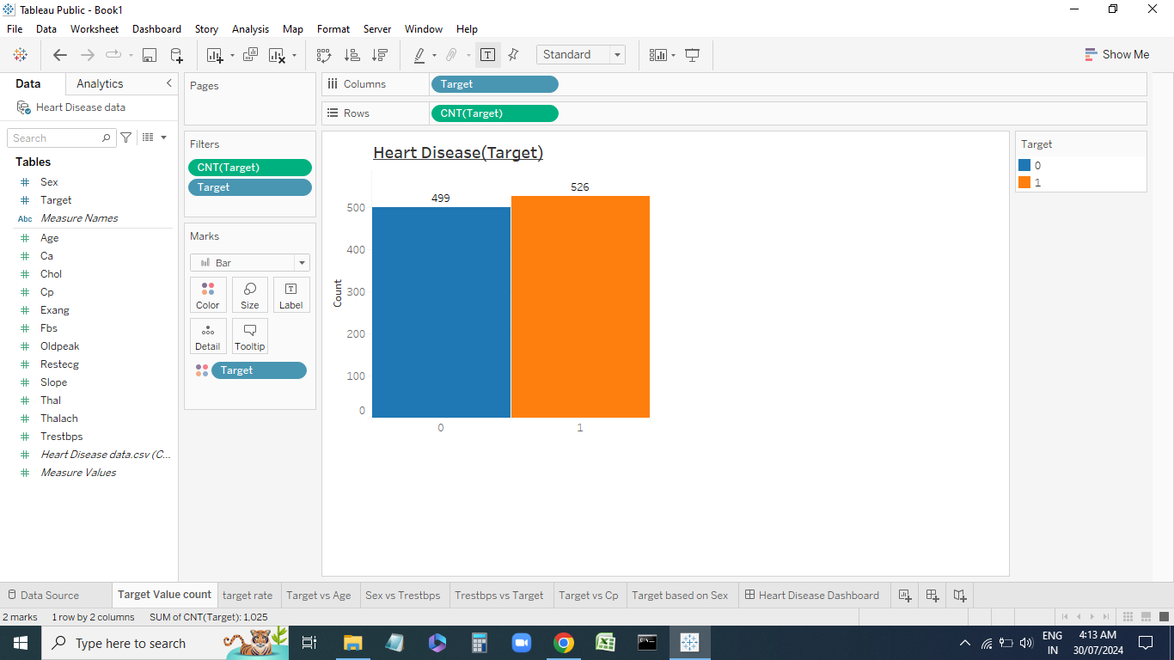
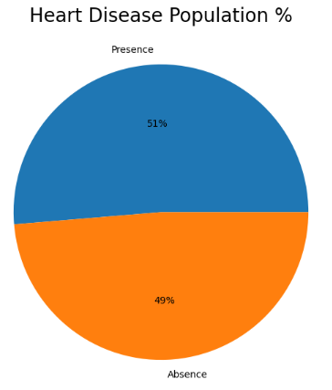

Heart Disease Rate

Slide 10
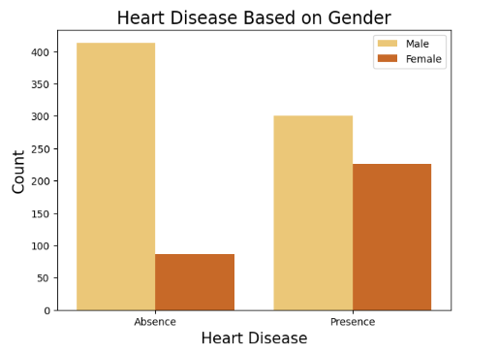
Heart Disease Based On Gender
Based on this plot we can say Male patient has more chance of heart disease than female. Because Heart Disease presence in Male patient more that Female patient.

Slide 11
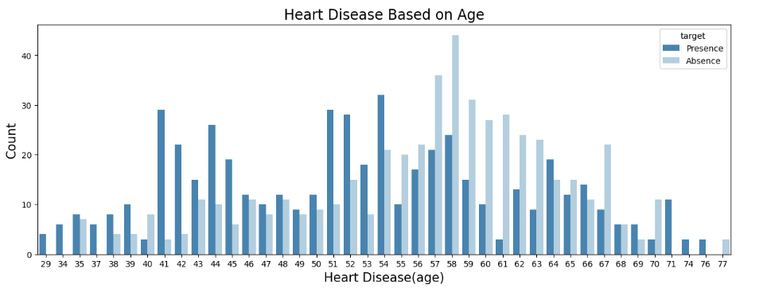
Heart Disease Based On Age
At the age range between 41 to 60 chance of heart disease is very high and others are 50-50 percent. If age is less than 30 their is less chance of heart disease.

Slide 12
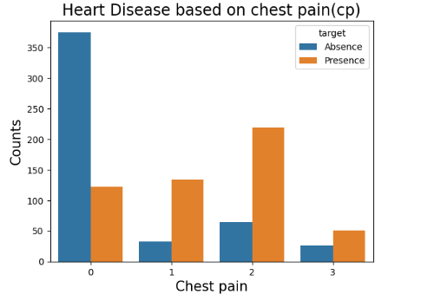
Heart Disease Based On CP
It seems people having type-2 chest pain have a higher chance of heart disease.

Slide 13
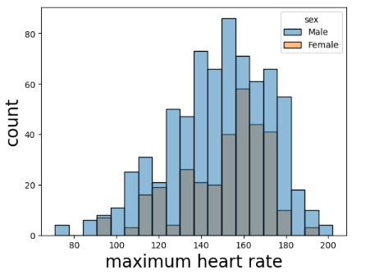
Maximum Heart Rate Based On Gender
Since, we can say that males are achieved maximum heart rate. Females are having very less amount. Which you can see in this histplot.

Slide 14
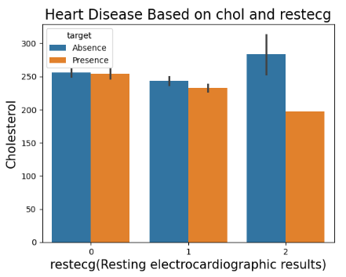
Heart Disease Based on Cholesterol and RestingECG
RELATION BETWEEN EKG RESULT AND SERUM CHOLESTEROL WITH RESPECT TO TARGET VERIABLE(HEART DISEASE).

Slide 15
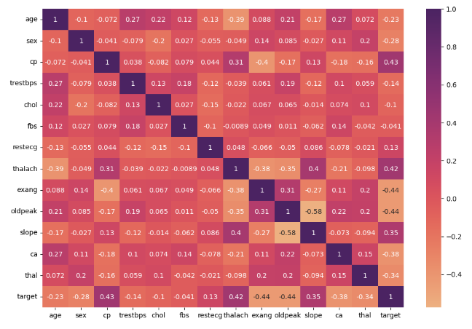
Correlation of the data attributes

Slide 16
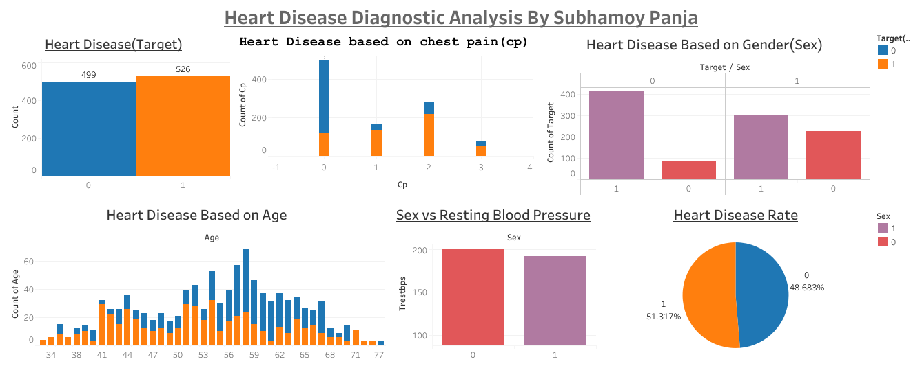
Dashboard Using Tableau

Slide 17
Conclusion
This is a classification problem with the target variable having values '0' and '1'. Here '0' means patient without heart problems and '1' means patient with heart problems.
There is NO MISSING Values in our Dataset
We have used 'Male' and 'Female' instead of 1 and 0 for "sex" column, 'Absence' and 'Presence' instead of 0 and 1 for "target" column.
Here in our dataset we get in the 'target' column, 526 patient with heart disease and 499 patient without heart disease problems.
From the overall population, people having heart disease (51%) are greater than those who have not heart disease(49%).
The role of exploratory data analysis using Tableau provided a visual appealing and accurate visualization of heart disease.

Slide 18
Thank you

